Slide 1






Git
Super Basics
Notes:
Max: Welcome to Git Super Basics. My name is Max Bronsema and I work at Western Washington University in Bellingham, WA.
Vid: My name is Vid Rowan and I work at the University of Oregon. We hope you are in the right room. As you get settled please take a look at the reference sheet to prime yourselves on the vocabulary.
Max: Vid and I use git at our jobs at WWU and the UO and what we will be sharing with you are some basic methods of using git. In git there are many ways to accomplish a task so if you have seen it done differently it is probably a valid way to do it. If you use git a lot, you may not get much from this session, but if you are new to it or have never touched it except to install it prior to this session you are in the right place.
Next Slide

Slide 2
What is Git?
Version Control System (VCS)
Successor to SVN in the Drupal eco-system
A tool
Notes:
Max: Git is a version control system created by Linus Torvalds, the creator of Linux. Apparently the word is British slang for a stupid or unpleasant person. So, we are going to use a stupid content tracker today. It has rapidly increased in popularity and is used by many projects and individuals today. It replaced subversion as the version control system for the Drupal project and is now how we apply patches, pull the latest code, and generally manage projects.
Version control systems such as git simply allow us to track changes to files at any point in time. Think of saving a file name with a new file name every time you update a file. Git kind of does that but you get to keep the same file name and can see the history of all the changes made.
With software development and our Drupal websites git is a tool we can use to streamline workflows and allow us a safety in case we really screw up. It also allows us to collaborate with the Drupal community.
Next Slide

Slide 3
Common Use Cases
Store incremental changes of files locally
Share your files and changes with others
Compare changes between file versions
Notes:
Here we just need to discuss the common use cases. Not much detail is needed though.

Slide 4
Basic Tasks
Initialize a repository
Adding and staging files
Committing changes
Removing files
Notes:
Vid: To get started with git we need to learn about the following tasks. We are going to take you through a simple project that we have setup on GitHub.
Switch to Terminal
Make a new folder for the project and go into it.
Create a new repository $ git init
Add the HTML5 starter template file into the project folder.
Add a stylesheet file to the project folder.
$git status
Discuss what the status screen is saying
$git add filename
$git status
Show one file is added and another is in the directory but not added
$git add .
$git commit -m "Initial Commit"
Explain that commit messages should be fairly short and descriptive
Add an extra file that we don't want to track like a .project file
Show how to untrack the file
$git rm --cache filename will untrack the file

Slide 5
Basic Tasks
Initialize a repository
$ mkdir test
$ cd test
$ git init
Initialized empty Git repository in /Applications/MAMP/htdocs/test/.git/
Notes:
Vid: To get started with git we need to learn about the following tasks. We are going to take you through a simple project that we have setup on GitHub.
Switch to Terminal
Make a new folder for the project and go into it.
Create a new repository $ git init
Add the HTML5 starter template file into the project folder.
Add a stylesheet file to the project folder.
$git status
Discuss what the status screen is saying
$git add filename
$git status
Show one file is added and another is in the directory but not added
$git add .
$git commit -m "Initial Commit"
Explain that commit messages should be fairly short and descriptive
Add an extra file that we don't want to track like a .project file
Show how to untrack the file
$git rm

Slide 6
Basic Tasks
Adding and staging files
$ ls
helloworld.txt
$ git add helloworld.txt
$ git status
# On branch master
#
# Initial commit
#
# Changes to be committed:
# (use "git rm --cached <file>..." to unstage)
#
# new file: helloworld.txt
#
Notes:
Vid: To get started with git we need to learn about the following tasks. We are going to take you through a simple project that we have setup on GitHub.
Switch to Terminal
Make a new folder for the project and go into it.
Create a new repository $ git init
Add the HTML5 starter template file into the project folder.
Add a stylesheet file to the project folder.
$git status
Discuss what the status screen is saying
$git add filename
$git status
Show one file is added and another is in the directory but not added
$git add .
$git commit -m "Initial Commit"
Explain that commit messages should be fairly short and descriptive
Add an extra file that we don't want to track like a .project file
Show how to untrack the file
$git rm

Slide 7
Basic Tasks
Committing changes
$ git commit -m"initial commit"
[master (root-commit) 6b53e5d] initial commit
1 file changed, 2 insertions(+)
create mode 100644 helloworld.txt
Notes:
Vid: To get started with git we need to learn about the following tasks. We are going to take you through a simple project that we have setup on GitHub.
Switch to Terminal
Make a new folder for the project and go into it.
Create a new repository $ git init
Add the HTML5 starter template file into the project folder.
Add a stylesheet file to the project folder.
$git status
Discuss what the status screen is saying
$git add filename
$git status
Show one file is added and another is in the directory but not added
$git add .
$git commit -m "Initial Commit"
Explain that commit messages should be fairly short and descriptive
Add an extra file that we don't want to track like a .project file
Show how to untrack the file
$git rm

Slide 8
Basic Tasks
Removing files
Deleting a file
$ git rm helloworld.txt
Untracking a file (removing a file from git)
$ git rm --cache helloworld.txt
Notes:
Vid: To get started with git we need to learn about the following tasks. We are going to take you through a simple project that we have setup on GitHub.
Switch to Terminal
Make a new folder for the project and go into it.
Create a new repository $ git init
Add the HTML5 starter template file into the project folder.
Add a stylesheet file to the project folder.
$git status
Discuss what the status screen is saying
$git add filename
$git status
Show one file is added and another is in the directory but not added
$git add .
$git commit -m "Initial Commit"
Explain that commit messages should be fairly short and descriptive
Add an extra file that we don't want to track like a .project file
Show how to untrack the file
$git rm

Slide 9
The Git Log and Reverting
What is the git log?
Comprehending the git log
What can we do with the git log knowledge?
$ git log
1 commit 6b53e5d04a13085f5924e99cd736bb086c7dde87
2 Author: Vid <vid@uoregon.edu>
3 Date: Fri Oct 19 23:20:11 2012 -0700
4
5 initial commit
Notes:
Max: The git log allows you to look into what has been happening in the repository. Here you will be able to see the list of commits in the project and the commit message. The command is straightforward.
$git log
Now, what does all of this stuff mean. The first part of what you see is the Commit Hash. This is a unique identifier for the filesystem at the time the commit was made. You can move your file system to any commit if you know the hash.
The second part is the author tag that is set by each user and their email address.
Third is the date down to the second for the commit. (Research more about the default date format)
The 4th part is the commit message itself.
Vid: We can use the git log information in the following ways.
Knowing the commit hash lets us revert back to that particular point in time.
We can see who made the commit if we are working jointly on a project.
We can see a diff of what changed with each commit. $ git log -p -3 (the -3 just limits the commits shown to 3)
Using -stat we can see stats, the number of insertions and deletes on each commit $ git log --stat
Max: The git log becomes more useful as the projects become complex and are great when you create branches.
Next Slide

Slide 10
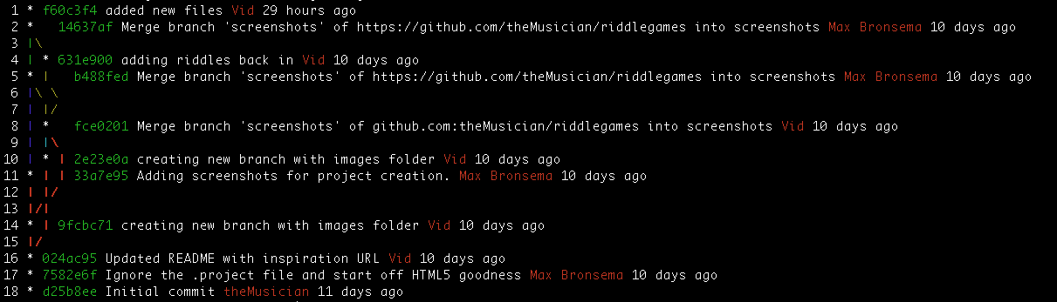
The Git Log and Reverting
$ git log --graph --decorate --pretty=format:'%Cgreen%h%Creset %s %Cred%an%Creset %ar'
1 * f60c3f4 added new files Vid 29 hours ago
2 * 14637af Merge branch 'screenshots' of https://github.com/theMusician/riddlegames into screenshots Max Bronsema 10 days ago
3 |\
4 | * 631e900 adding riddles back in Vid 10 days ago
5 * | b488fed Merge branch 'screenshots' of https://github.com/theMusician/riddlegames into screenshots Max Bronsema 10 days ago
6 |\ \
7 | |/
8 | * fce0201 Merge branch 'screenshots' of github.com:theMusician/riddlegames into screenshots Vid 10 days ago
9 | |\
10 | * | 2e23e0a creating new branch with images folder Vid 10 days ago
11 * | | 33a7e95 Adding screenshots for project creation. Max Bronsema 10 days ago
12 | |/
13 |/|
14 * | 9fcbc71 creating new branch with images folder Vid 10 days ago
15 |/
16 * 024ac95 Updated README with inspiration URL Vid 10 days ago
17 * 7582e6f Ignore the .project file and start off HTML5 goodness Max Bronsema 11 days ago
18 * d25b8ee Initial commit theMusician 11 days ago
Notes:
Max: The git log allows you to look into what has been happening in the repository. Here you will be able to see the list of commits in the project and the commit message. The command is straightforward.
$git log
Now, what does all of this stuff mean. The first part of what you see is the Commit Hash. This is a unique identifier for the filesystem at the time the commit was made. You can move your file system to any commit if you know the hash.
The second part is the author tag that is set by each user and their email address.
Third is the date down to the second for the commit. (Research more about the default date format)
The 4th part is the commit message itself.
Vid: We can use the git log information in the following ways.
Knowing the commit hash lets us revert back to that particular point in time.
We can see who made the commit if we are working jointly on a project.
We can see a diff of what changed with each commit. $ git log -p -3 (the -3 just limits the commits shown to 3)
Using -stat we can see stats, the number of insertions and deletes on each commit $ git log --stat
Max: The git log becomes more useful as the projects become complex and are great when you create branches.
Next Slide

Slide 11
Branches
What is a branch?
Why to use branches
Create a branch
Switching between branches
Example: Checkout a prior commit
$ git branch mars
$ git checkout mars
$ git checkout -b pluto d0f4aa3
Notes:
Note: When creating a local branch you'll want to set the upstream branch to track: 'git branch --set-upstream screenshots origin/screenshots'
Vid: A git branch takes a snapshot of your present code and then allows you to make changes without the code at the time you create the branch. When you are done working in a branch you can switch to another branch and if necessary, merge the changes together. In Drupal branches are often used when you are trying to create a patch for a module or core issue.
Max: To create a new branch, first make sure the branch you are currently on has no outstanding commits, or staged files.
$ git status
If there are changes, make sure to commit the changes before proceeding.
$ git commit . -am "Change description."
The shorthand for creating a branch and automatically switching to it is
$ git checkout -b branchName
Once you do this the filesystem is now aware of the newly checked out branch and not your previous branch. As you make changes in this code you are diverging from the master branch.
You can switch back to the master or another branch at any time. To see the differences between branches you will want to use a diff tool if the changes are more than a few lines of code.
To delete a branch simply use -d to remove the branch. -D will force remove it.
$git checkout -d branchName
Next Slide

Slide 12
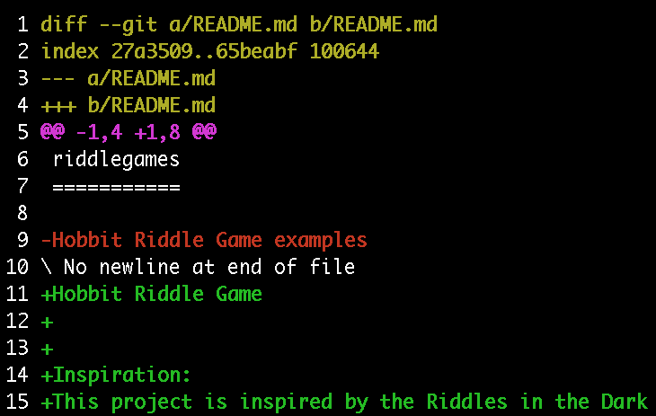
Diffing
What is a diff?
Reading diff output
Tools to make life better
Notes:
Vid: A diff is a comparison between two files which shows the differences. Using git you can merge the changes between a file on different branches. You sometimes need to do this when moving your changes into a branch that has been updated.
$ git diff
with no options will show the differences between the files that are not yet staged.
$ git dff --staged
shows the diff of files that have been staged.
$git diff hash1 hash2
will show the difference between the two commits specified by the hash. --stat will give you the stats and not the diff.
The default diff tool can be a bit clunky. I prefer to use diffmerge. e.g. $ git difftool -t diffmerge file|hash|branch
To go back one commit after another, use this nice line created by Vid"
$ git checkout HEAD~1;git diff HEAD^ --stat
$ git checkout master;
$ git difftool -t diffmerge styles riddles.html
Next slide.

Slide 13
Patches
Create a patch
$ git checkout -b emailwording
$ git diff 8.x
$ git -am "Patch to fix issue 950534."
$ git diff 8.x > consistent_email_950534_08.patch
Notes:
Max: Now that you can create branches and generate diffs patches can make some sense. Patches in git simply identify files and then make changes to them. Patches are convenient because you can be working in a branch and then diff your branch against the production branch to create a patch. Now anyone else with the same production branch can apply the patch over a myriad of files. No need to make changes by hand.
To create a patch (The Drupal Way http://drupal.org/node/707484):
(Make a patch from alternatestyle to styles)
Ensure you have the latest version of the code you wish to create a patch for.
Create a new branch with the following format. $ git branch [IssueNumber]-[IssueDescription]
The issue number is the node number on drupal.org
Make your changes. When you are done making the changes use diff to see the changes that will go into the main code. $ git diff branchToDiffAgainst
If everything looks good. Stage and commit your changes. $ git -am "Patch to fix issue # 123456789."
git diff branchToDiffAgainst > [project_name]-[short_description]-[issue-number]-[comment-number].patch
Applying a patch:
Make sure you have committed any current changes, git status should be clean.
Download and save the file as a .patch file
Navigate to the module or core system you wish to apply the patch for
Test the patch and then apply it.
$ git apply --check /path/to/patch
$ git apply -v /path/to/patch
Test the changes and if you are happy, commit the changes. If you are unhappy, discard the changes.
To commit the patch
$ git commit -m “Applied patch http://drupal.org/node/id
To discard the patch
$ git checkout *

Slide 14
Patches
Apply a patch
$ git apply --check -v /path/to/patch
$ git apply --stat /path/to/patch
$ git -am "Patch to fix issue 950534."
$ git apply -v /path/to/patch
Notes:
Max: Now that you can create branches and generate diffs patches can make some sense. Patches in git simply identify files and then make changes to them. Patches are convenient because you can be working in a branch and then diff your branch against the production branch to create a patch. Now anyone else with the same production branch can apply the patch over a myriad of files. No need to make changes by hand.
To create a patch (The Drupal Way http://drupal.org/node/707484):
(Make a patch from alternatestyle to styles)
Ensure you have the latest version of the code you wish to create a patch for.
Create a new branch with the following format. $ git branch [IssueNumber]-[IssueDescription]
The issue number is the node number on drupal.org
Make your changes. When you are done making the changes use diff to see the changes that will go into the main code. $ git diff branchToDiffAgainst
If everything looks good. Stage and commit your changes. $ git -am "Patch to fix issue # 123456789."
git diff branchToDiffAgainst > [project_name]-[short_description]-[issue-number]-[comment-number].patch
Applying a patch:
Make sure you have committed any current changes, git status should be clean.
Download and save the file as a .patch file
Navigate to the module or core system you wish to apply the patch for
Test the patch and then apply it.
$ git apply --check /path/to/patch
$ git apply -v /path/to/patch
Test the changes and if you are happy, commit the changes. If you are unhappy, discard the changes.
To commit the patch
$ git commit -m “Applied patch http://drupal.org/node/id
To discard the patch
$ git checkout *

Slide 15

Merging
Merging branches
$ git checkout master
$ git merge styles
Notes:
Vid: Merging two branches means simply taking the changes from one branch and joining them with the other branch. Often a merge will be necessary after you created a branch to fix an issue and you want to share that fix with the production branch.
Let's say that the styles branch is deemed to be the one we want to launch with. To merge those changes we use the merge command on the branch we want to merge with. For this example lets checkout the master branch.
$ git checkout master
Then we identify the branch we want to merge and use the merge command.
$ git merge styles
You will then often see the words Fast Forward or "Merge made by recursive" and the stat of what files changed. In this case riddles.html and styles.css
Basic Git Merge Conflicts:
Next Slide

Slide 16
Working with Remotes
SSH Keys
$ ssh-keygen -t rsa -C "your_email@youremail.com"
Pull
$ git push origin master
Push
$ git pull origin master
Clone
$ git clone --recursive --branch 8.x http://git.drupal.org/project/drupal.git
Notes:
Max: The great thing about git is that you can work with others and share code from a central resource. This is what github, bitbucket, and firewalled solutions like gitolite and stash are all about. To do this effectively we need to talk with those resources and push and pull code from it.
SSH Keys are needed with many systems, though some HTTPS authentication systems are gaining popularity. For this session we will use SSH keys. Generating a key is pretty straightforward and in doing so you create a private key which you keep on your system and a public key that you can share with others. If you have keys already, make sure you know the passphrase and give us a few moments to generate them for others.
From your prompt quickly check that no key exists.
$ cd ~/.ssh
$ ls
If something appears it means you have keys. If you were not aware of that, make a backup quickly in case they are important. (These steps are from gitHub's great write-up)
mkdir key_backup cp id_rsa* key_backup rm id_rsa*
Now we are going to generate a key.
$ ssh-keygen -t rsa -C "your_email@youremail.com"
Enter file in which to save the key (/your_home_path/.ssh/id_rsa):
Enter a passphrase twice and you now have keys to use with most git resources.
Vid: Now that we have keys what in the world would you do with them? Get some code.
Everything you have been learning applies when working with a remote git repository because with git you have your local repo that you update from central but you can work without being connected. So,
there are two concepts we want to go over, pushing and pulling.
You pull from a repository whenever you want to get the latest code. In Drupal you can pull in the latest changes to the dev branch of core or a module.
You push to a repository when you have code to contribute back. If you do not own the project you need permission to push but the idea is that you have made some changes to the code, merged them into the master branch and are now sharing that with others who can now pull your code down.
Max and I have a project on github called riddlegames. Make a new directory on your computer wherever you save projects and we will clone that project. Cloning is a special type of pull that grabs all of the code and automatically sets up a link between your copy and the project.
$ git clone git://github.com/theMusician/riddlegames.git
Now if I make a change, say we push the merge we made earlier we can see that the changes are updated on the remote server.
$ git push origin master
To see those changes, you just need to pull in the changes.
$ git pull origin master
To clone D8 you want the following
$ git clone --recursive --branch 8.x http://git.drupal.org/project/drupal.git
cd drupal

Slide 17
Relax Your Brain
Thank You
Questions?
Links: 2012.pnwdrupalsummit.org/sessions/git-super-basics
Max Bronsema - http://maxbronsema.com
@theMusician
Vid Rowan - http://uoregon.edu/~vid

